Slide 1
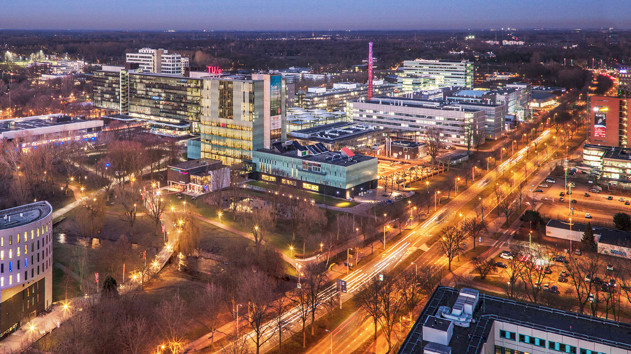

Synthetic Data-Driven Mismatch Detection for Updating Building Information Models from a Single Viewpoint
Pepijn Hundepool
26-06-2025

Slide 2
Contents
Introduction
Methodology
Results
Discussion
Conclusion

Slide 3
Introduction
BIM
Real-world synchronization
Mobile robots
Mismatch detection
Notes:
The Architecture, Engineering, and Construction (AEC) industry is increasingly driven by digitalization, with Building Information Models (BIMs) getting more attention as foundational tools for representing, analyzing, and managing built environments. A BIM is a digital twin of a building that includes its geometric, semantic, and functional properties, serving as a central source of information throughout the lifecycle of a building.
As BIMs become more popular, their real-world synchronization becomes an important challenge. Buildings are dynamic, often undergoing changes such as construction, renovations or daily operations. This misalignment between the digital BIM and the physical world can lead to poor decisions, safety assessments, and facility operations.
One possible solution involves integrating robotics into BIM workflows. Mobile robots equipped with 3D sensors can autonomously scan environments, detect discrepancies, and assist in keeping BIMs up-to-date. This could help update BIMs more accurately and efficiently, with potential uses in construction, building inspections, and facility management.

Slide 4
Research Question
Detecting structural mismatches in indoor environments
Single viewpoint
Only synthetic training data
DT-scan and Robot-scan
“How can structural mismatches in indoor environments be detected using per-point predictions from 3D scan pairs generated from a single simulated viewpoint?”
Notes:
This research investigates whether structural mismatches in indoor environments can be detected from a single simulated 3D viewpoint using only synthetic training data. The aim is to develop a practical method for identifying changes, such as added or removed walls and pillars, between a digital twin scan (DT-scan) that represents the BIM-state, and a simulated real-world scan (robot-scan) that represents the real-world state, which can ultimately support real-time updates of Building Information Models (BIMs).
The main research question therefore is: How can structural mismatches in indoor environments be detected using per-point predictions from 3D scan pairs generated from a single simulated viewpoint?

Slide 5
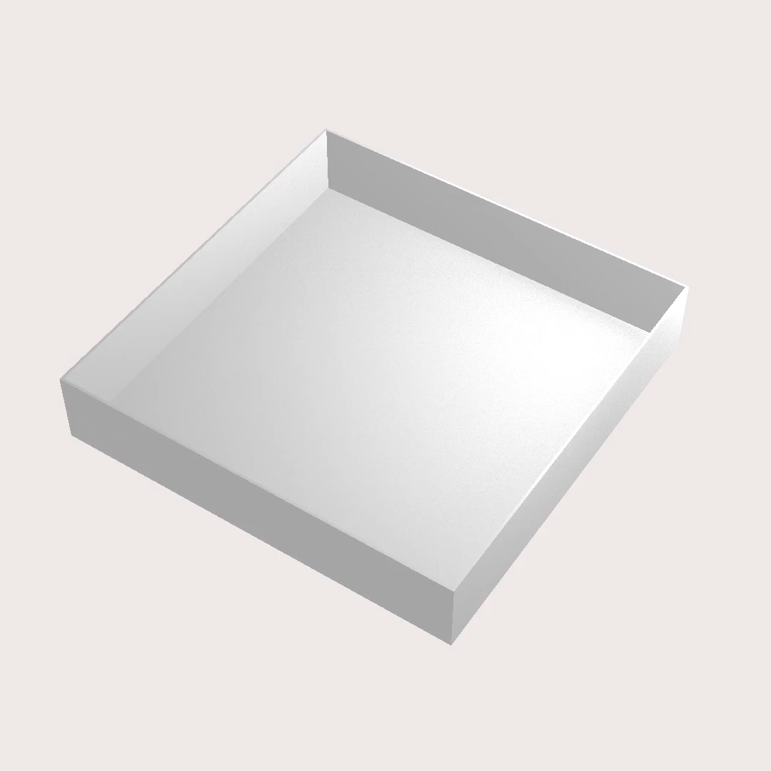
Room Generation
Parametric dataset generator
Object set
Random room layouts
Serve as digital twins
Parametric Dataset Generator developed by Pim van den Akker in: “A Parametric Dataset Generator For Updating Digital Twins Through 2D LiDAR Perceptual Data”, (2024).
Notes:
Randomized indoor scenes are generated in Blender using a parametric dataset generator developed in prior work. Each scene includes structural elements, such as walls, pillars and doors, as well as optional non-structural objects like chairs and tables. The generator allows us to vary room layouts, object placements, and dimensions across samples. These synthetic scenes serve as digital twins, providing clean reference environments with known geometry and semantic labels for training and evaluation. I will now show some examples.

Slide 6
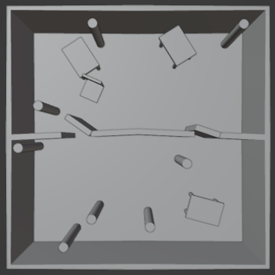
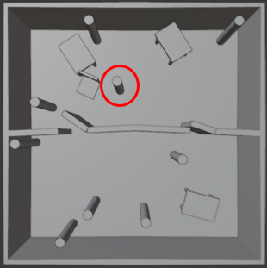
Scenario: Pillar Added
Original
Modified

Slide 7
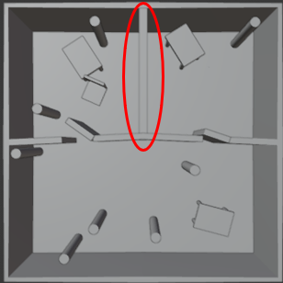
Scenario: Wall Added
Original
Modified

Slide 8
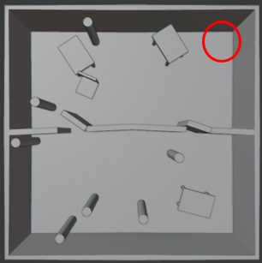
Scenario: Pillar Removed
Original
Modified

Slide 9
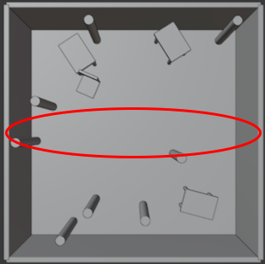
Scenario: Wall Removed
Original
Modified

Slide 10
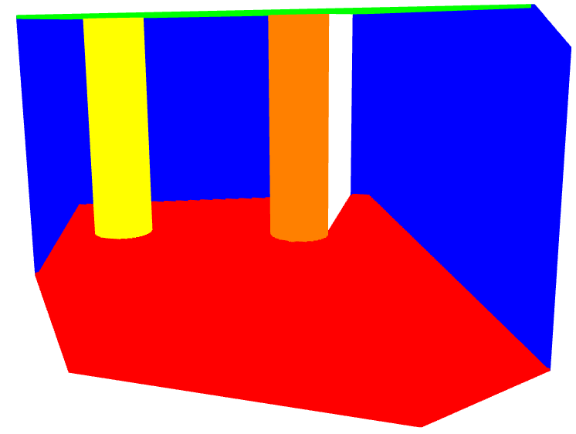
3D Sensor Simulation
Virtual RGB-D camera
Geometry and semantics
Direct instance-level grouping
Scan example. Objects are coloured by categoryID.
Notes:
To simulate realistic 3D scans, the generated scenes are scanned using the BLAINDER add-on inside Blender. A virtual RGB-D camera is positioned at a height of 1 meter. This height improves structural coverage given the limited vertical field of view (VFOV) of such sensors.
BLAINDER produces both clean scans and occluded scans (scans with non-structural clutter like chairs or tables). It outputs point clouds with geometry and semantic labels in the form of a categoryID, which is a float value that identifies object instances. This enables instance-level grouping without requiring a separate segmentation model, though it does limit real-world applicability, where such labels are typically not directly available. An example of a labeled scan can be seen here. It must be noted here that the categoryID is used here only for visualization.

Slide 11
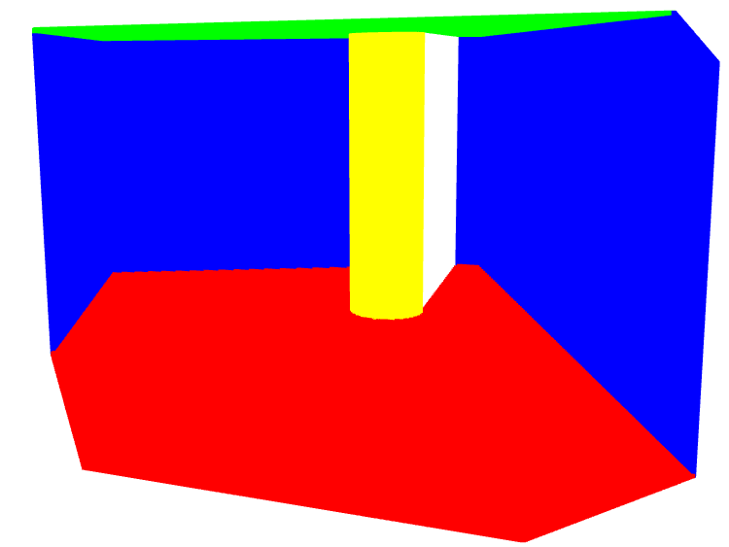
Mismatches and Scenario Control
DT-scan
Mismatches
Occluding objects
Pre-aligned scenes
First single mismatch, then multiple
DT-scan
Robot-scan
Notes:
Each scene is first saved in its original form as a DT-scan, representing a BIM-aligned point cloud with only structural elements. Mismatches are then introduced, such as the addition or removal of walls or pillars, and optional disturbances (e.g., chairs, tables) are added to create the robot-scan, simulating a real-world perception.
In real-world indoor settings, movable objects like chairs and tables frequently obstruct the sensor’s line of sight. These are therefore used as occlusion sources in the robot-scans to reflect realistic visual obstacles, as commonly encountered in indoor environments.
This project uses a registration-free setup by leveraging pre-aligned synthetic scenes, which eliminates the need for scan alignment and allows precise control over mismatch scenarios. However, the assumption of perfect alignment between the DT-scan and robot-scan is a limitation when actual hardware is used to create the robot-scan. In practice, this can be addressed by saving the robot-scan’s camera parameters and localization point during scan generation and replicating these settings during DT-scan creation in Blender.
During training, each scene contains only a single type of mismatch (e.g., pillar removed, wall added) to isolate feature learning and simplify interpretation. In later experiments, multiple mismatches are introduced to evaluate a model’s generalization. An example raw scan pair for the pillar added scenario is shown here.

Slide 12
Export Format and Data Structure
BLAINDER .csv files
Sensor noise initially disabled
Converted to .npy
Notes:
BLAINDER allows for exporting point clouds as .csv files, along-side other formats, where each row corresponds to a point and includes spatial coordinates (X, Y, Z) and a categoryID for semantic labeling. Other metadata fields (e.g., partID, distance to sensor, intensity, RGB values) are exported but not used in this project.
Sensor noise simulation was intentionally disabled to maintain full control over scene geometry and labels during development. This allowed for easier debugging and consistent evaluation. Once the core pipeline is validated, noise can be added to study domain transfer effects.
In a later step, each point is annotated with a binary label indicating mismatch presence, and a distance feature is computed based on nearest-neighbor queries between scan pairs. The final .csv files are converted to .npy format for efficient loading during training.

Slide 13
Data Preprocessing
Clutter
Downsampling
Label Generation
Data augmentation
Formatting
Notes:
Before training, each synthetic scene is passed through a structured preprocessing pipeline to improve data consistency and realism. Raw scans may contain non-structural clutter and variable point densities, which can interfere with mismatch detection. The preprocessing includes five main steps: object filtering, downsampling, mismatch label generation, data augmentation, and formatting. These steps ensure that the net-work receives clean, well-annotated input and learns to detect structural mismatches reliably. While the overall pipeline is consistent across scenarios, some logic (e.g., label generation) is tailored to specific mismatch types.

Slide 14
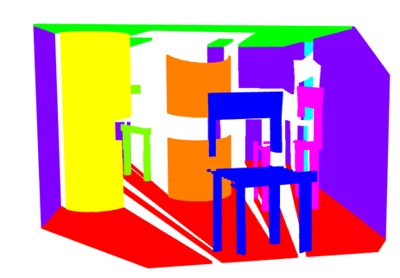
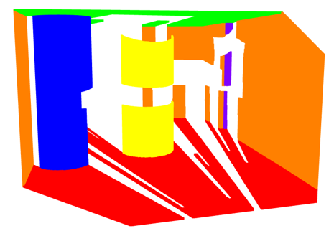
Object Filtering
Non-structural elements
Robot-scan
CategoryID & height
Assume access to semantics
Raw scan
Object-filtered scan
Notes:
In indoor scans, movable objects such as furniture or tools may appear alongside structural elements like walls and pillars. These non-structural points can introduce noise and lead to false positives during training. To address this, a filtering step removes irrelevant points from the robot-scan based on two criteria: semantic class (categoryID) and height. Structural elements typically span a significant height, while the considered clutter in this work remains near the floor. Objects are retained only if their height exceeds a threshold (e.g. 2 meters), with exceptions for floor and ceiling regions. This approach assumes access to semantic labels, which in this project are provided by BLAINDER but may not be directly available in real-world scans, thus requiring an extra prior segmentation step. An example is shown here.

Slide 15
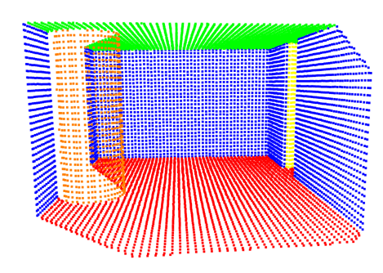
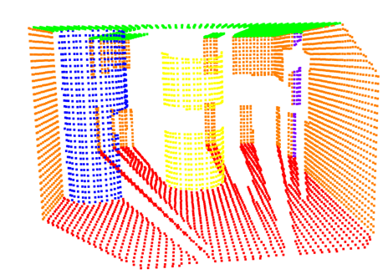
Downsampling
Reduce memory usage
Voxel downsampling
Smoothing effect
DT-scan downsampled
Robot-scan downsampled
Notes:
To ensure uniform point density and reduce memory usage during training, all DT-scan and robot-scan point clouds are voxel-downsampled using a resolution of 0.1 meters. This step also reduces noise and redundancy, helping the model generalize better. An example of a downsampled scan pair is shown here.

Slide 16
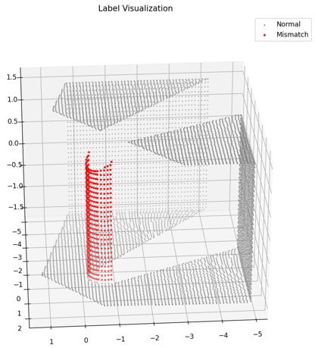
Label Generation & Filtering
Accurate per-point labels
Nearest-neighbour distance
Scenario-dependent
Unchanged cases
Generated labels for a pillar-added scenario
Notes:
Accurate per-point labels are essential for supervised mismatch detection. Each point in a DT-scan or robot-scan is labeled as a mismatch (1) or not (0) by comparing it to the opposite scan using nearest-neighbor distance. A KD-tree is used to compute distances, and points exceeding a defined threshold are labeled as mismatched.
The labeling logic depends on the scenario. In removal cases, mismatches are labeled in the DT-scan since these indicate objects present in the DT-scan but absent from the robot-scan (object was removed from the real world). In addition cases, mismatches are labeled in the robot-scan since these points indicate objects present in the robot-scan but absent from the DT-scan (object was added to the scene). In unchanged cases, all points are labeled 0. An example of label generation for the pillar-added scenario is shown here.

Slide 17
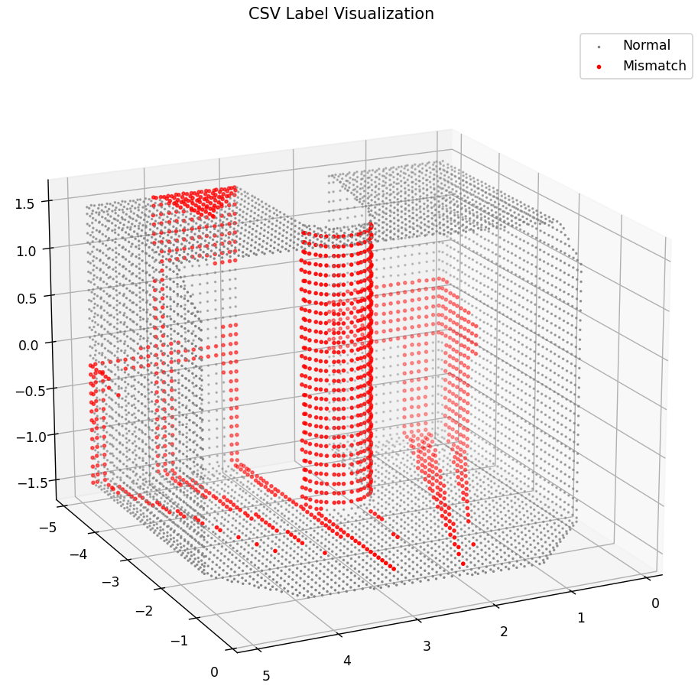
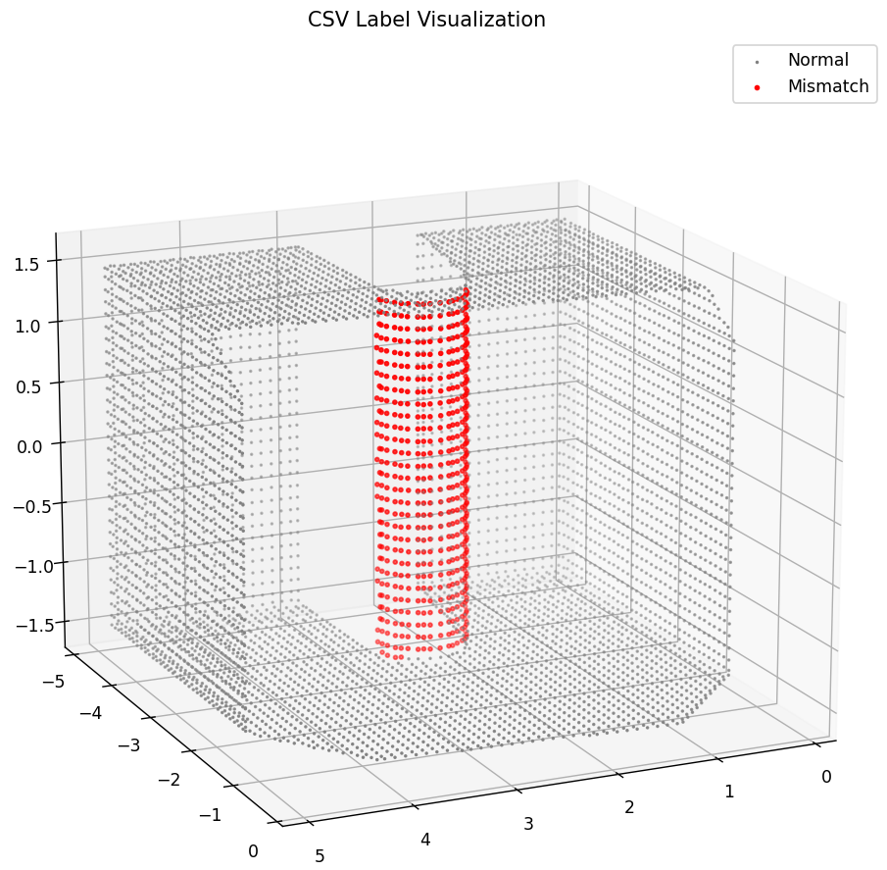
Label Generation & Filtering
Occlusion shadows
False mismatches
DT-scans have no occlusions
Cluster-based filtering
Generated labels
Filtered labels
Notes:
The label generation process for removed objects can be influenced by occlusion shadows, particularly when objects block the sensor’s view. This often results in false mismatches being labeled on nearby surfaces such as ceilings, walls or floors around removed objects. The reason why this happens is that during labeling for removed objects we find for every point in the DT-scan, the nearest point in the robot-scan, compute the distance between these two points and if this distance exceeds a certain threshold, the point in the DT-scan is marked as mismatched, but since the DT-scans are always empty of movable objects like chairs and tables, while these can be present in robot-scans and cause shadows in the robot-scans, the points in the DT-scan that lie in these robot-scan shadows are marked as mismatched, because there are no points there in the robot-scan. This problem does not occur in added-object-scenarios since we mark points in the robot-scan there.
To reduce false positives caused by occlusion shadows, a clustering-based label filtering step is applied. This removes small, misaligned clusters that may result from missing points behind occluding furniture. The filtered label files serve as the final ground truth for training. These high-quality labels greatly reduce false positives during inference and allow the model to learn robust mismatch detection patterns. See example here.

Slide 18
Data Augmentation
Prevent overfitting to absolute coordinates
Pair-wise spatial augmentations
Random rotation and/or translation
Notes:
To improve generalization and prevent overfitting to absolute coordinates, spatial augmentations are applied to each DT-scan and robot-scan pair. Since the model focuses on relative geometry rather than global position, it must learn to be invariant to transformations.
For each scene, three augmented versions are created by applying a rotation around a random axis, translation using a random 3D offset and combined rotation and translation. Transformations are applied consistently to both scans in a pair to maintain alignment of mismatch labels.

Slide 19
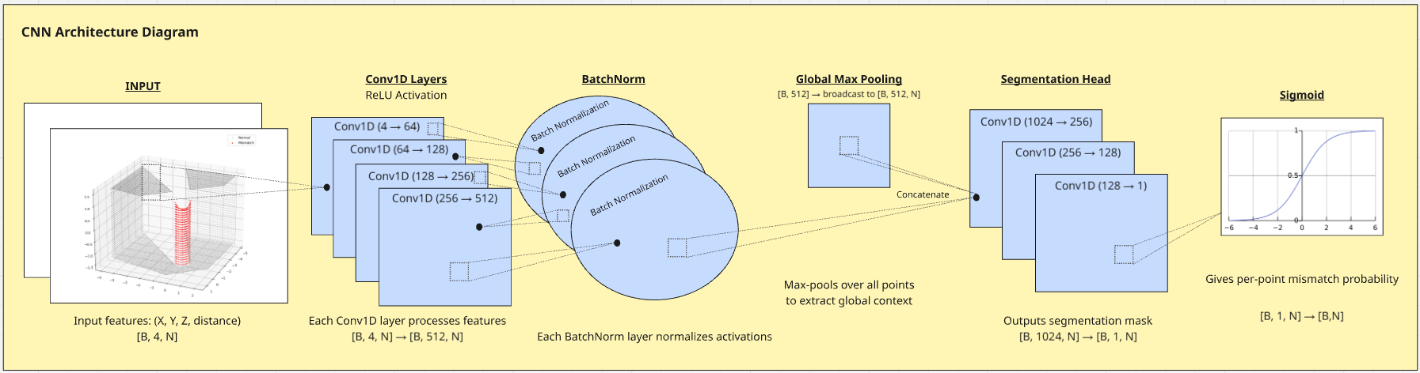
Mismatch Detection Neural Network Architecture
Per-point classification
Mismatch probability
Notes:
The proposed model is a 1D Convolutional Neural Net-work (1D-CNN) inspired by PointNet, designed to detect geometric mismatches in point cloud data. It performs per-point classification on either the DT-scan or robot-scan, with the opposing scan used only to compute an additional nearest-neighbour distance feature. An overview of the architecture is shown here. The output is a per-point mismatch probability between 0 and 1.

Slide 20
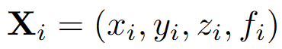
Input Representation
Feature vector
Paired with a label file
Unchanged samples
Notes:
Each point in the preprocessed cloud is represented as a feature vector where: x, y, z denote the global coordinates of the point, and f represents a nearest neighbour distance feature. Each point cloud is paired with a label file containing binary mismatch annotations. To improve robustness and false positives, the training set also includes unchanged scenes, rooms where the DT-scan and robot-scan are identical. These scenes help the network learn to recognize normal geometry and avoid overfitting to the presence of structural changes. Including such negative examples is crucial for realistic deployment, where many scans may contain no mismatches at all.

Slide 21
Testing
Testing each specialized model on controlled single-mismatch scenarios.
A set of ablation studies to evaluate model robustness to occlusion, feature loss, and augmentation.
Selecting the best specialized mismatch detection model for test cases where mismatch type is unknown beforehand.
Validation on scans derived from real BIM (IFC) models.
Testing each specialized model on controlled multi-mismatch scenarios.
Notes:
This section outlines the five-stage evaluation process used to validate the mismatch detection pipeline. The experiments are as follows:
1) Testing each specialized model on controlled single-mismatch scenarios.
2) A set of ablation studies to evaluate model robust-ness to occlusion, feature loss, and augmentation.
3) Selecting the best specialized mismatch detection model for test cases where mismatch type is unknown beforehand.
4) Validation on scans derived from real BIM (IFC) models.
5) Testing each specialized model on controlled multi-mismatch scenarios.

Slide 22
Scenario-Specific Evaluation Setup
Scan selection based on mismatch type
Inference
Thresholded outputs
95% recall as operating point
FPR, precision, IoU, AUC
Notes:
Each specialized model is first tested independently on scenes containing a single mismatched object. For these controlled test cases, the correct scan is selected based on the mismatch type. In removal scenarios, the DT-scan is evaluated. In addition scenarios, the robot-scan is used. The nearest-neighbour feature is recomputed at test time using a KD-tree. Inference is performed by feeding the preprocessed scan into the trained model, which outputs per-point probabilities ˆyi ∈ [0, 1]. Model outputs are thresholded to produce binary predictions so that points can be categorized into True Positives, False Positives, True Negatives and False Negatives. Rather than fixing this threshold, we identify the operating point where recall reaches 95%, and report the corresponding False Positive Rate, precision and IoU values, alongside the ROC AUC score. This ensures fair comparison across models under a controlled minimum-recall condition.

Slide 23
Ablation studies
Removing the nearest-neighbour distance as an input feature, so training the models only on coordinates
Removing the X,Y,Z as input features, so training the models only on nearest-neighbour distance
Removing occluded samples from the training set, so training the model on clean samples only
Test the models on a scan pair that is misaligned
Removing augmented samples from the training set
Inclusion of sensor noise.
Notes:
To investigate the model’s robustness, several ablation tests are performed on the single-scenario models. These isolate the contribution of specific training components. The tests that are done are:
Removing the nearest-neighbour distance as an input feature, so training the models only on coordinates
Removing the X,Y,Z as input features, so training the models only on nearest-neighbour distance
Removing occluded samples from the training set, so training the model on clean samples only
Test the models on a scan pair that is misaligned
Removing augmented samples from the training set
Inclusion of sensor noise.

Slide 24
Full Pipeline Model Selection
Run all models in parallel
Fixed threshold
Model selected if bounding box is fitted
Clusters of mismatched points
Bounding box shape is guided by model type
Notes:
In a realistic testcase, it is unknown beforehand whether a mismatch has occurred and if so, what the mismatch is. All four trained models are thus applied in parallel. For each model, per-point predictions are generated and thresholded, using a fixed threshold (e.g., 0.5). A model is selected if it produces at least one valid bounding box after mismatch detection. PCA-based bounding boxes are fitted to clusters of predicted mismatched points that result from using DBSCAN clustering. Bounding box fitting is guided by the object type known from the selected model (e.g., ’pillar-removed’), which helps filter out irrelevant shapes and improves robustness to occlusions and sensor noise. Dimension bounds for boxes can be set if needed be.

Slide 25
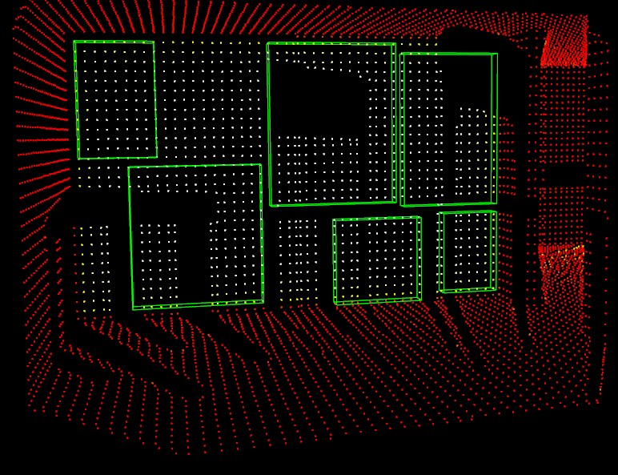
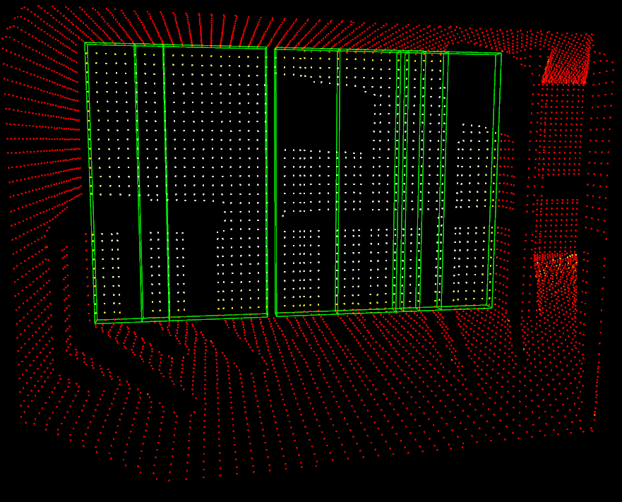
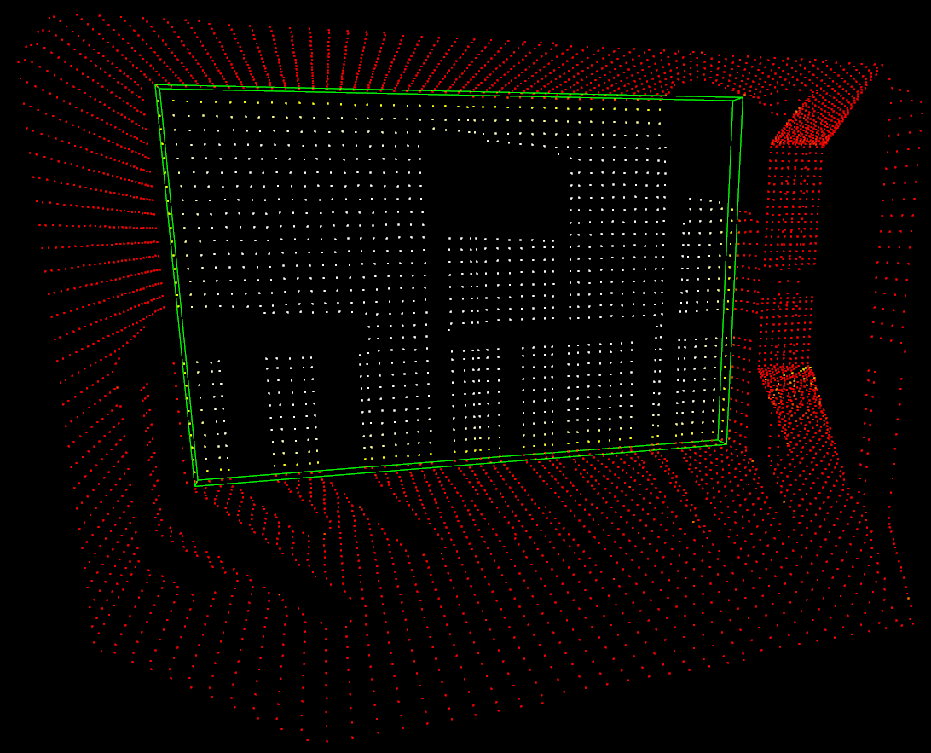
Full Pipeline Model Selection
First boxes
Manhattan world assumption
Vertical stretching
Assumed wall thickness
Duplicate boxes
Merge overlapping wall boxes
Trim all floor and ceiling points
Vertically stretched
Merged
Notes:
Axis-Aligned Bounding Boxes (AABBs) are used for both pillar and wall bounding boxes, leveraging the Manhattan world assumption that most objects in indoor environments, in our case the structural elements, align with the global axes. Bounding boxes can be configured to be vertically stretched to match the full Z-span of the point cloud, see figures, since clusters of mismatched points may not always span the entire vertical of an actual mismatched object. Since walls are generally thin in one dimension and the depth dimension of walls can never be seen from a single viewpoint, we fix the smallest non-vertical dimension to a modifiable constant 0.15 meters for all predicted wall bounding boxes. Duplicate boxes across models can be suppressed using center-distance filtering, ensuring that each detected mismatch is represented once. Overlapping wall bounding boxes that align can be merged so that one complete wall bounding box is obtained and not several, see Figure 66. To improve robustness against unwanted shadow artefacts, it is also possible to trim all mismatched points near the floor and ceiling of the point cloud before fitting a bounding box or to discard clusters that have a too large percentage of points on the floor or ceiling. These post-processing steps are all configurable settings within the current implementation.

Slide 26
Full Pipeline Model Selection
“A pillar has been added at [-0.3 -0.4 0.] with dimensions [0.34 0.34 3.].”
Overlay boxes onto prior BIM for validation
Leverage BIM for shape completion
BIM is not ground truth!
Notes:
The final output of the pipeline is a structured sentence, or collection of sentences if there are multiple mismatched objects, that summarizes a detected mismatch. This output is generated from the fitted bounding box metadata and contains four key components: the object type (pillar or wall), the mismatch type (added or removed), the bounding box center, and the bounding box dimensions. An example of such a sentence is: “A pillar has been added at [-0.3 -0.4 0.]with dimensions [0.34 0.34 3.].”
The resulting bounding boxes can be overlaid onto the prior BIM to first check whether the bounding box is valid and not falsely produced by for example a shadow artefact. If an "object-added" box overlaps with an already existing object at that location, or if an "object-removed" box is fit around an empty space in the prior BIM, the produced box is likely false. If a bounding box is incomplete because of the limited visibility challenge in this work, the prior BIM could be leveraged to complete shapes where needed. The BIM can also be used to identify the shape of an object. If an object is removed, the shape is already known and if an object is added, the assumption could be made that the shape is similar to surrounding objects of the same type. It must be noted here that the BIM is thus not used as a ground truth, but rather as a prior map. The BIM can then be updated through the remaining fitted bounding boxes.

Slide 27
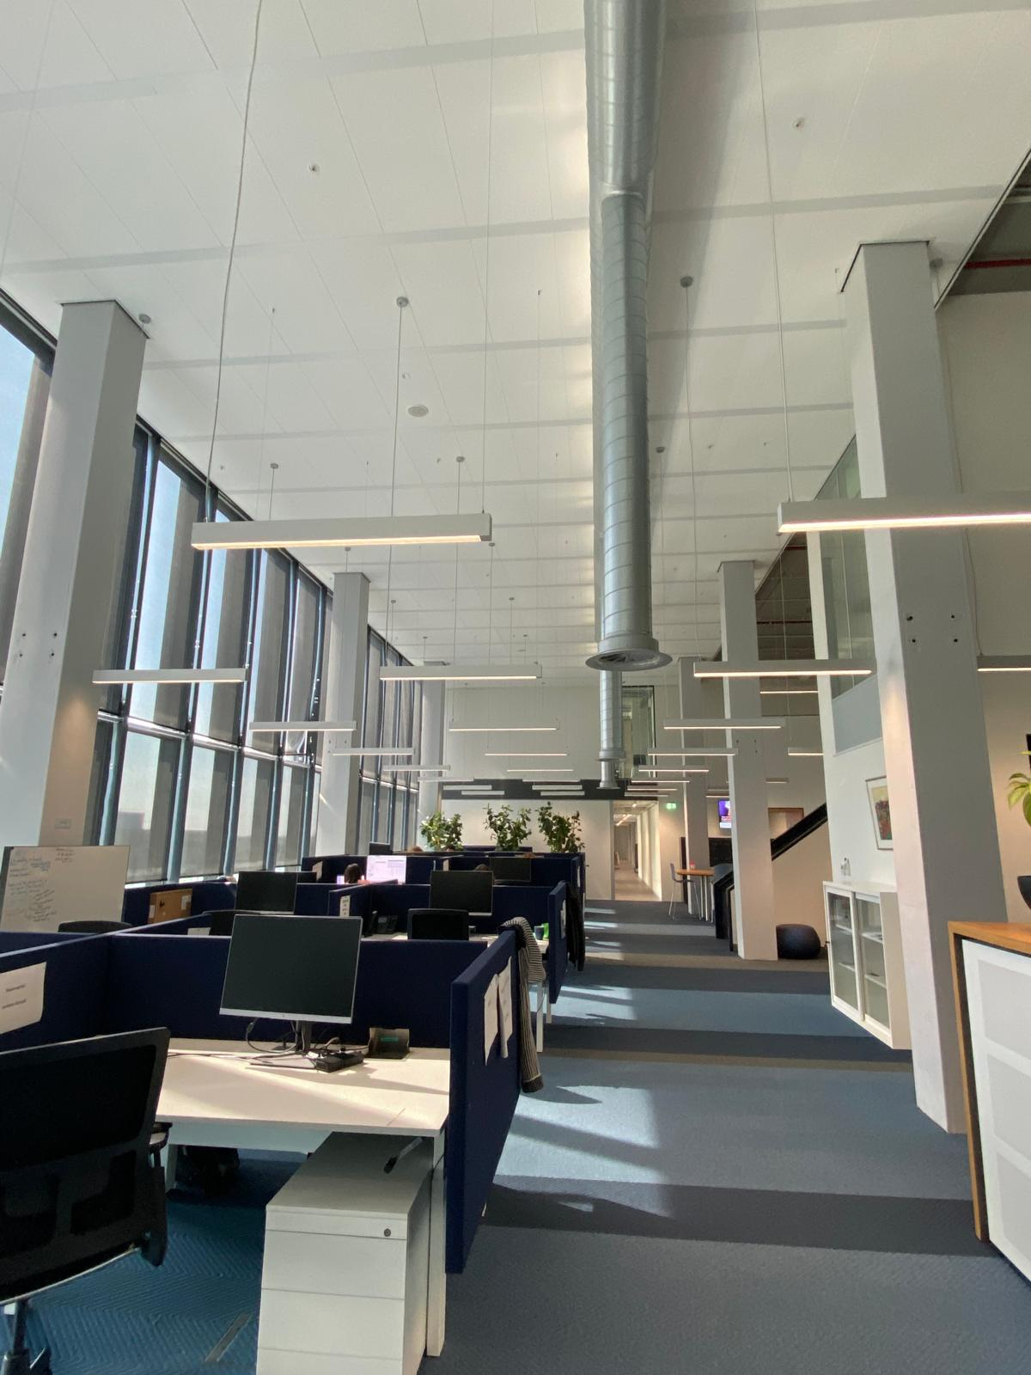
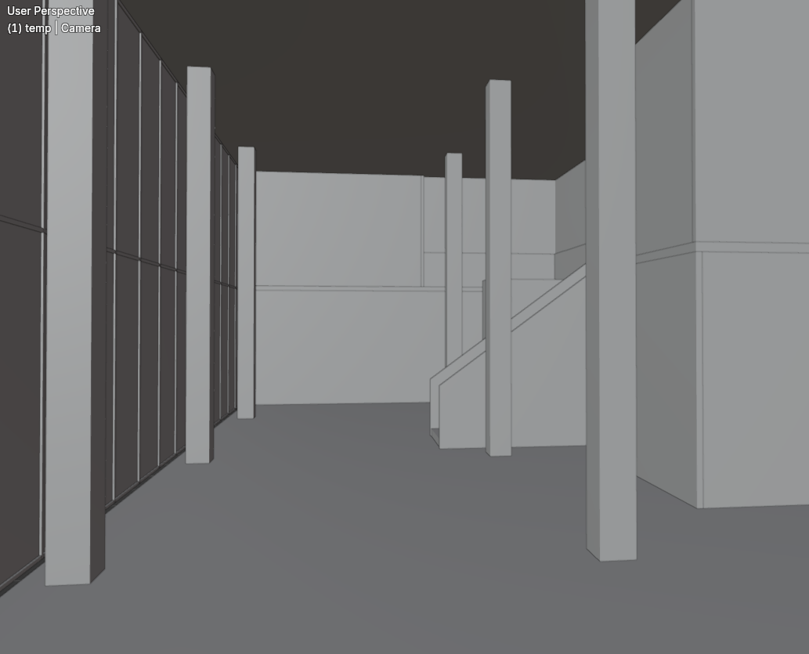
Semi-Real-World Validation
IFC model
Real deployment
Atlas-8 real world
Atlas-8 BIM
Notes:
To simulate a deployment setting, a semi-real-world test is performed on a room scanned from an actual IFC model. An example of the real atlas-8 floor and IFC version of it can be seen here. This test provides insight into the pipeline’s readiness for real-world use, where the mismatch type is unknown and all models must be considered.

Slide 28
Multi-Mismatch Scenario Evaluation
Multiple objects of the same type and mismatch(e.g., several removed pillars)
Multiple objects of different types but the same mismatch (e.g., walls and pillars added)
Multiple mismatch types across the same object class (e.g., one pillar removed, another added)
Fully mixed scenes with several types and mismatch categories
Notes:
In this last testing stage, the framework is tested on scenes that contain multiple mismatches. The four different scenarios are now transformed into ingredients that can be used to create an infinite number of different multi-mismatch cases. These more complex test cases include:
Multiple objects of the same type and mismatch(e.g., several removed pillars)
Multiple objects of different types but the same mismatch (e.g., walls and pillars added)
Multiple mismatch types across the same object class (e.g., one pillar removed, another added)
Fully mixed scenes with several types and mismatch categories
These cases test the pipeline’s ability to scale, avoid redundant detections, and correctly localize all mismatches.

Slide 29
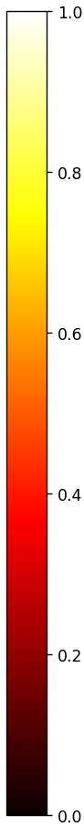
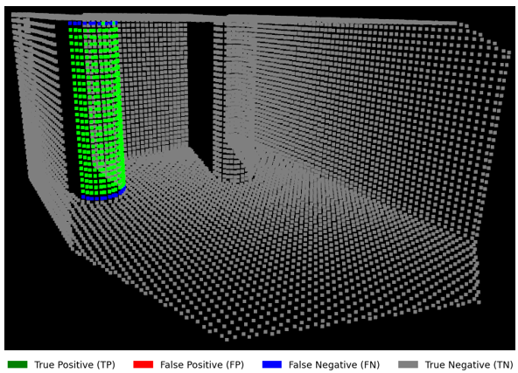
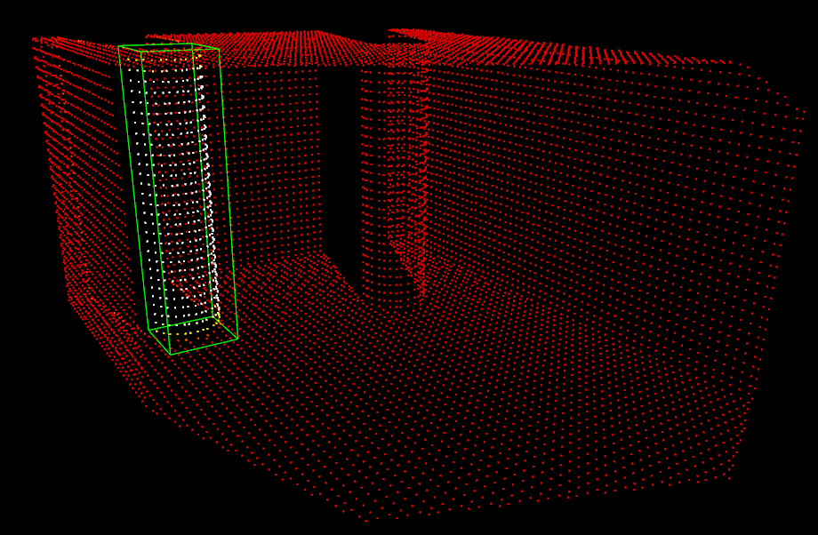
Pillar-Added Model – Clean Case
Classification map
Heatmap
Notes:
This model was trained to detect newly added pillars in robot-scans. Score metrics and visualizations, clean test case shown here, confirm that the model detects added pillars with high precision and spatial accuracy. The classification map shows no false positives and few false negatives while the heatmap shows strong activation only around the added pillar.

Slide 30
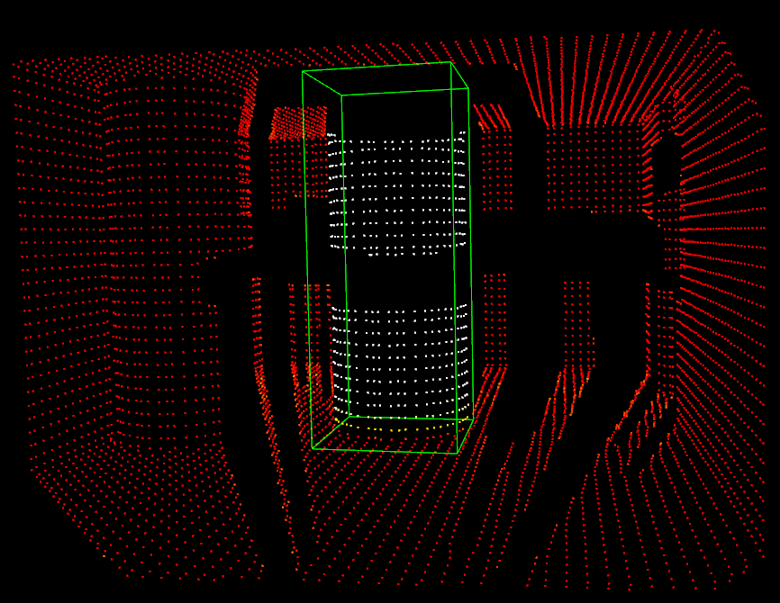
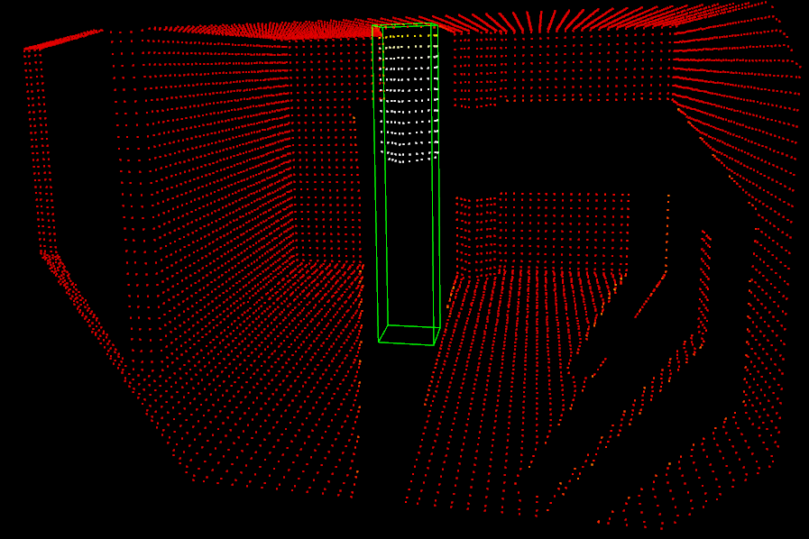
Pillar-Added Model – Occluded Case
Notes:
The model detects added pillars even under occlusion. In the figure on the left, a chair was standing in front of the pillar and the pillar on the right was blocked by a table. Note how we still manage to get full bounding boxes.

Slide 31
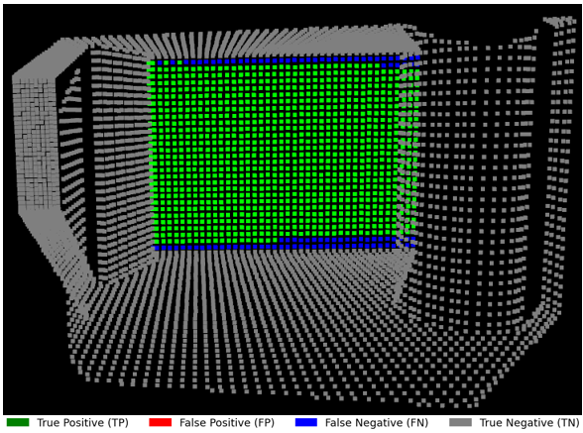
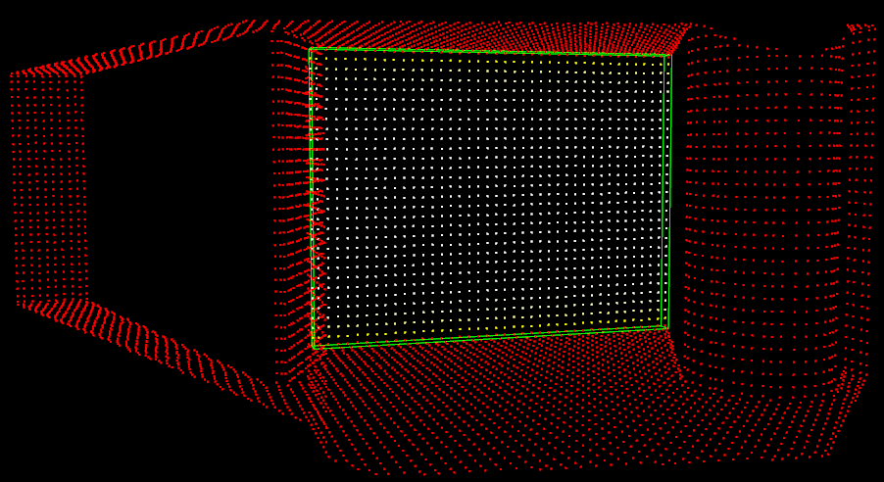
Wall-Added Model – Clean Case
Classification map
Heatmap
Notes:
This model was trained to detect newly added walls in robot-scans. Visualizations confirm that the model localizes added walls with high spatial precision and very few false positives.

Slide 32
Wall-Added Model – Occluded Case
Notes:
Performance remains consistent even in cluttered scenes with occlusion, demonstrating that the model has learned to robustly identify added structural elements under realistic conditions.

Slide 33
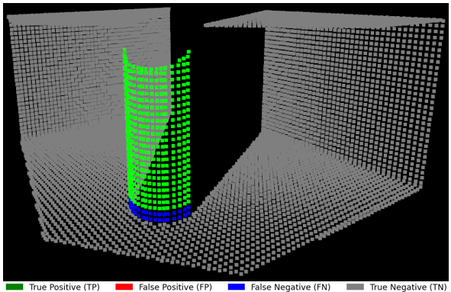
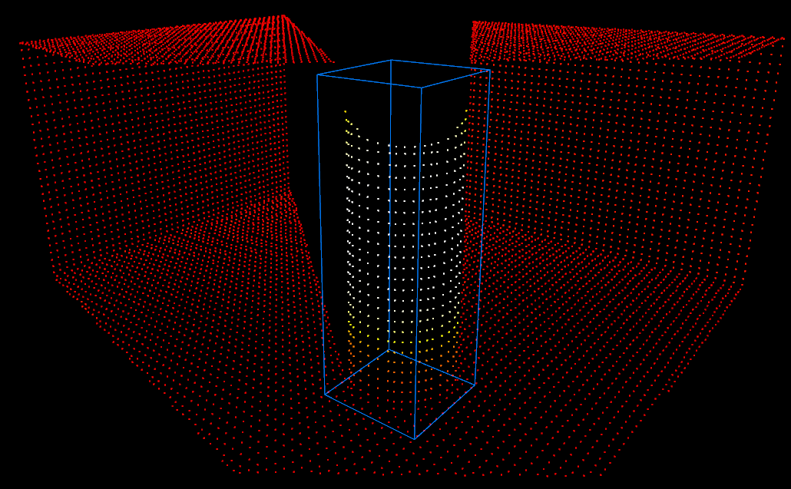
Pillar-Removed Model – Clean Case
Classification map
Heatmap
Notes:
This model was trained to detect removed pillars in DT-scans. Visualizations confirm that the model consistently localizes the removed pillar. In the clean test case, predictions are highly accurate with minimal errors.

Slide 34
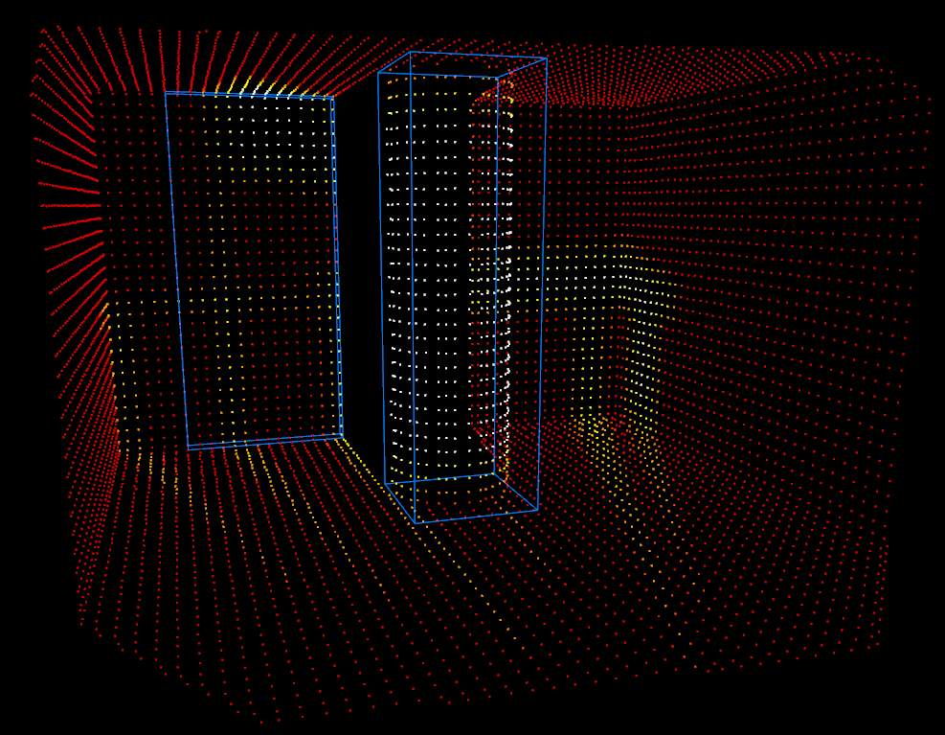
Pillar-Removed Model – Occluded Case
Notes:
In the occluded case, while the removed object is still correctly identified, the model produces a number of false positives, particularly on surfaces affected by occlusion shadows. The chair shadow here on the left incorrectly gets its own bounding box. These errors do not stem from the labeling process before training, which has been refined to filter out shadow artifacts, but rather from the nearest-neighbour distance feature used during training. This is the first testcase where such shadow-induced false positives visibly degrade performance, highlighting a known limitation of the distance-based feature in removal scenarios.

Slide 35
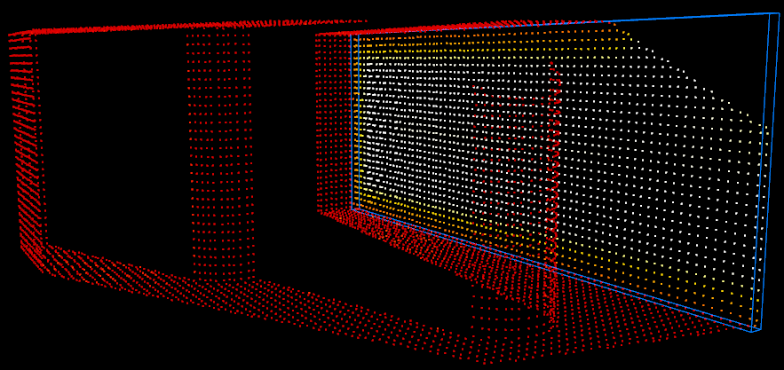
Wall-Removed Model – Clean Case
Notes:
This model was trained to detect removed walls using DT-scans. Visualizations confirm accurate detection of the removed wall in clean scenes, with minimal classification error.

Slide 36
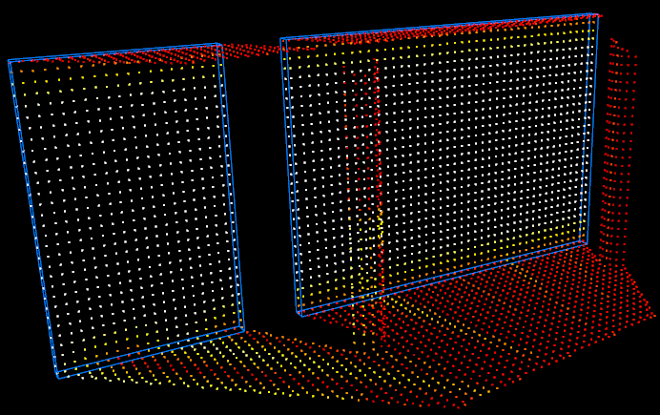
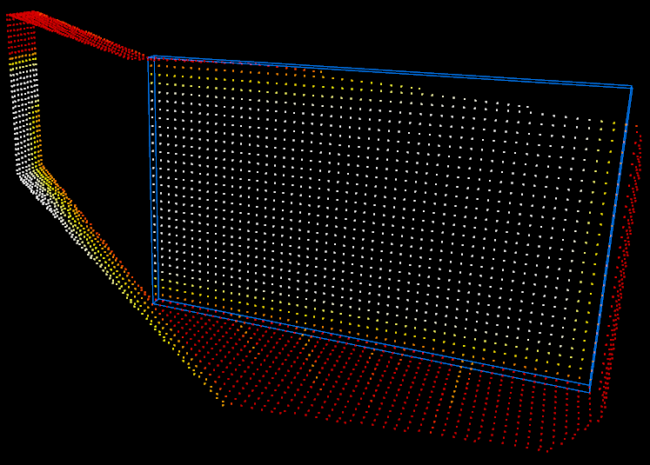
Wall-Removed Model – Occluded Case
Notes:
In the occluded testcase, however, regarding score metrics, the model shows a drop in performance: the ROC AUC drops significantly compared to other scenarios, and both precision and IoU decline similarly to the occluded pillar-removed case. This is again caused by false positives arising from shadowed regions, where the nearest-neighbour distance feature misleads the model into labeling background points as mismatches. It must be noted that the removed wall is successfully detected completely in both of these figures, even though shadow artefacts are present.

Slide 37
Ablation Study
NN-distance is essential
Coordinates provide spatial context
Mixed data is needed
Scan alignment is required
Data augmentation only introduces noise
Sensor noise barely hurts performance
Notes:
Now that we’ve looked at the core model performance, I want to briefly summarize the ablation studies we conducted to better understand which features and design choices really matter.
First, the nearest-neighbor distance feature was removed and retrained and a model was retrained. The result was that the model completely failed. It could not detect any mismatches. This confirmed that NN-distance is essential, since it is the only signal that encodes the geometric discrepancies between the scans.
Next, the XYZ coordinates were removed instead, keeping only the NN-distance. Interestingly, the model still worked on clean cases but performed worse on occluded scenes. So while NN-distance carries the mismatch signal, global coordinates provide spatial context, especially for understanding object boundaries under occlusion.
Then it was researched what happens if we only train on clean scenes, avoiding any occluded samples. While the clean test performance remained the same, the model lost robustness in more challenging, occluded setups. So clean data alone is not enough, mixed data is better.
What if the DT-scan and robot-scan are not aligned perfectly like I have assumed? Small misalignments didn’t hurt much on clean scenes, but occluded scenes became much harder, the shadow artifact problem got worse. This highlights the need for robust alignment in real deployments.
Next, we looked at data augmentation. Surprisingly, removing it improved performance under occlusion. This suggests that our dataset already contains enough natural variation, and that augmentation might be introducing unnecessary noise.
Finally, we tested sensor noise, adding Gaussian noise to simulate real-world sensor imperfections. The model remained highly robust, with only minor false positives near object edges. This robustness is largely due to our voxel downsampling and the use of NN-distance.

Slide 38
Evaluation of Full Pipeline with Model Selection
Visibility constraints
Notes:
The full mismatch detection pipeline was evaluated using a model selection strategy that relies on bounding box validity. While per-point predictions are accurate, bounding box fitting performance is naturally limited by the visibility constraints of the scene. The produced bounding boxes were geometrically reasonable in the majority of cases. In all successful cases, the bounding box encloses the mismatched object from the observed viewpoint. In pillar cases, the center of the predicted bounding box is offset toward the sensor due to only the front-facing surface being visible and the cluster of mismatched points having a center closer to the sensor than the actual pillar center is, see example here. The orientation of the bounding box for square pillars is imperfect if the pillars themselves are not axis-aligned due to the Manhattan World assumption and PCA being applied only to the visible points, see example. For walls, the depth is always assumed to be 0.15 m, but occlusions can still produce partial bounding boxes (e.g., only one side of a wall that is visible).
Some edge cases were observed in the test set of synthetic rooms that contain only one mismatched object. First is an unwanted shadow artefact getting its own bounding box, as seen here. Another edge case is a square pillar that is not axis-aligned where only one of four faces is visible because the pillar is directly facing the sensor, making the pillar look like a wall. This is solved to some extent by the assumption that walls are axis-aligned, resulting in a pillar bounding box that is badly centered and oriented, see Figure 68. If the pillar was actually axis-aligned, then this cluster of mismatched points would have gotten a wall bounding box. There is also an edge case where a pillar is obstructing a middle portion of a wall, resulting in a split wall where only one portion gets a bounding box because the other portion is too small in length to be allowed to get a bounding box, see example. This minimum required length can be configured however.

Slide 39
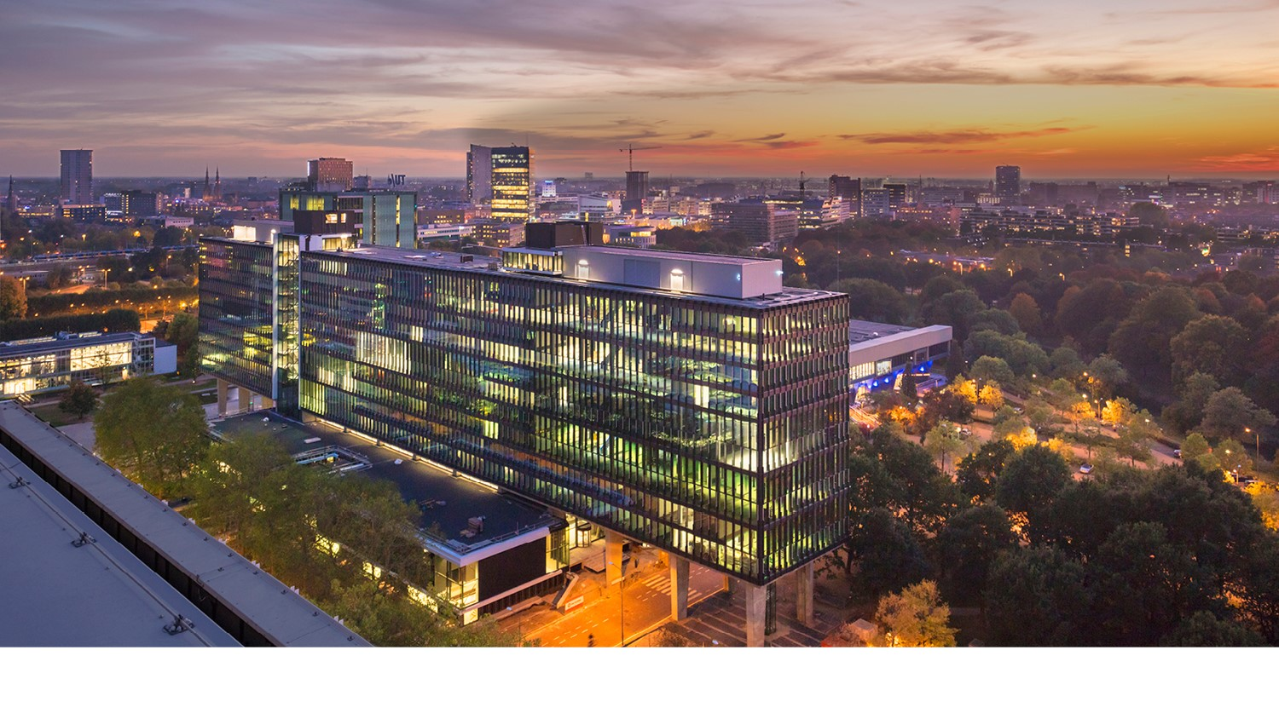
Questions?

Slide 40
Appendix - Research Questions
“How can structural mismatches in indoor environments be detected using per-point predictions from 3D scan pairs generated from a single simulated viewpoint?”
How can a fully synthetic data pipeline be designed to generate high-quality, labeled 3D scan pairs for training mismatch detection models?
Can simple, lightweight neural network models trained on synthetic data generalize to unseen scenes and identify different types of structural changes?
What is an effective way to validate mismatch detection in scenarios where no ground truth is available?
How can we evaluate and select predictions from multiple specialized models when the true mismatch type is unknown?
How do the trained mismatch detection models generalize to multi-mismatch scenes?
How can we create a bridge from mismatch detection to the updating of a BIM?
Notes:
The main research question therefore is: How can structural mismatches in indoor environments be detected using per-point predictions from 3D scan pairs generated from a single simulated viewpoint? To answer this, the following sub-questions are explored:
How can a fully synthetic data pipeline be designed to generate high-quality, labeled 3D scan pairs for training mismatch detection models?
Can simple, lightweight neural network models trained on synthetic data generalize to unseen scenes and identify different types of structural changes?
What is an effective way to validate mismatch detection in scenarios where no ground truth is available?
How can we evaluate and select predictions from multiple specialized models when the true mismatch type is unknown?
How do the trained mismatch detection models generalize to multi-mismatch scenes?
How can we create a bridge from mismatch detection to the updating of a BIM?
These questions are addressed by developing a pipeline with scenario-specific models, training them on generated synthetic scan pairs, and applying them to a wide range of test scenes, both synthetic and semi-real, to explore the limits of single-viewpoint, scan-vs-scan mismatch detection.

Slide 41
Appendix: 1D Convolutional Feature Extraction
Four 1D convolutional layers
ReLU
Batch normalization
Global max pooling
Concatenated with local features
Notes:
The network applies four sequential 1D convolutional layers with increasing channel dimensions, each followed by ReLU activation and batch normalization. After feature extraction, a global max pooling operation aggregates scene-level information. This global feature is then broadcast and concatenated with local features for each point, resulting in a combined feature tensor of shape(B, 1024, N ).

Slide 42
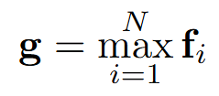
Appendix: Global Feature Pooling
Summarize most dominant features
Notes:
A global max pooling layer is applied to summarize the most dominant features across all points: where g is the global feature vector, and N is the number of points in the input scan.

Slide 43
Appendix: Segmentation Head
Per-point classifications
Sigmoid
Notes:
Following the pooled features, a segmentation head reconstructs per-point classifications through three additional Conv1D layers. A Sigmoid activation function is applied to the final output to produce per-point mismatch probabilities between 0 and 1.

Slide 44
Appendix: Loss Function
Binary Focal Loss
Class imbalance
α increases the penalty for false negatives
γ reduces the influence of well-classified examples
Notes:
The model is trained using a binary Focal Loss function to address class imbalance, defined as this where ˆyi is the predicted probability, yi is the ground truth label, and the hyperparameters are set to α =10.0, γ = 2.0. The weighting factor α increases the penalty for false negatives, helping the model focus on the minority class that is mismatched points. The focusing parameter γ reduces the influence of well-classified examples, allowing the model to better learn from harder or ambiguous cases. This is especially important for detecting subtle geometric changes in noisy or cluttered point clouds.

